Slide 1
Unique Desert Safari
The desert safari provides about 20 twinkles of instigative drift bashing along with an stimulating camp trip where you can enjoy quadrangle biking, camel lift and beach skiing. Morning safari can vary according to your package stint. On average, some of the companies offer about 2- hour package trip.

Slide 2
Unique Desert Safari
A unique desert safari can be a customized experience that is tailored to your preferences and interests. Many tour operators in the Middle East offer bespoke desert safari packages that allow you to create a personalized itinerary based on your needs
.
For More Information Visit To DESERT SAFARI
For instance, if you're an adrenaline junkie, you can opt for a desert safari that includes extreme activities like sandboarding, quad biking, or even dune bashing in a powerful off-road vehicle. On the other hand, if you prefer a more laid-back experience, you can choose a safari that focuses on relaxation and serenity, like a sunrise or sunset desert yoga session. If you're a foodie, you can opt for a desert safari that offers a gourmet dining experience under the stars. You can indulge in a variety of local delicacies and traditional Arabian cuisine, like grilled meats, hummus, falafel, and shawarma.

Slide 3
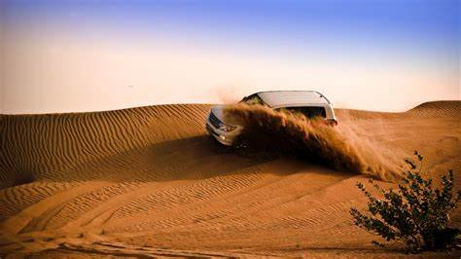
Unique Desert Safari

Slide 4
Unique Desert Safari
For those interested in learning about local culture and history, you can choose a desert safari that includes visits to historic sites, traditional villages, or museums. You can also opt for a safari that offers opportunities to meet with local people and learn about their daily lives and traditions. One unique desert safari experience that stands out is a hot air balloon ride over the desert at sunrise. This activity provides a breathtaking bird's eye view of the vast desert landscape and allows you to witness the natural beauty of the region from a unique perspective. Overall, a unique desert safari is one that is tailored to your interests and provides a personalized experience that you'll never forget. Whether you're looking for adventure, relaxation, or cultural immersion, there is a safari package out there that is perfect for you.
Get in touch with us: +971554020578

